Slide 1
CJT – Case 1

Slide 2
Clinical judgement test
Aims
Test clinical application and ability to justify clinical decision making
Knowledge of disease pathophysiology
Knowledge of the evidence base on which decision are made
Like a discussion on rounds
Allows candidates to give different answers – if they can justify them (with evidence)

Slide 3
Case
SIGNALMENT | 10-year-old Connemara pony mare presents in Ireland weighing 400kg BCS 3/5
PRESENTING SIGNS | Depression, ptosis of the left eye
Physical examination | Quiet, alert and responsive Temp: 37.3’C; respiratory rate 16 breaths per minute; Heart rate 38 bpm; normal sinus rhythm; no murmurs detected MM: pink and moist; CRT: < 2 sec Thoracic and abdominal auscultation – within normal limits No nasal discharge, no lymph node enlargement Cranial nerve examination: Persistent left eyelid ptosis; intermittent left ear droop, minimal left lip deviation No masseter/temporalis atrophy Menace response present both eyes, decreased left Right eye: normal position; normal physiologic nystagmus; PLR present Left eyeball: left pupil completely and constantly mydriatic; PLR absent Able to prehend food and swallow; good tongue tone Cervico-facial reflex present but decreased on left; no neck muscle atrophy Blind folding did not elicit a head tilt Posture evaluation Stood slightly wide and unbalanced in forelimbs Postural strength in all 4 limbs; no muscle tremors; Able to resist pulling on withers/tail When the right hind limb was lifted, the pony couldn’t bear full weight Panniculus reflex/dorsal and ventral spinal flexion reflexes present on both sides Tail tone, anal tone and anal/perineal reflexes – normal Neck flexion was normal to both sides, and up and down Conscious proprioceptive reflexes were present in all four limbs Gait evaluation On a straight line: normal at walk and trot On a tight circle in both directions Circumduction of hind legs; stepped on its own feet in the forelimbs Walking tail pull: Was less able to resist when being pulled to the left side; Normal resistance when being pulled to the right side

Slide 4
Question 1
What is your neuroanatomical localisation for this case? Justify your conclusions
Unacceptable | The borderline candidate | A new diplomate | The advanced diplomate
Unable to localise lesion correctly | Localises lesion to CNS | Localises lesion to brainstem | Localises lesion to midbrain or more specific location
Unable to give relevant justifications | Gives justification based on 1 relevant clinical signs | Gives justification based on multiple cranial nerve deficits | Discusses multiple cranial nerve deficits and evidence of ataxia

Slide 5
New information – provide to the candidate
You localise the lesion to the brainstem
Clinicopathological data are consistent with an inflammatory process (based on increased globulins, fibrinogen), although white cells numbers are unremarkable.
Upper respiratory tract endoscopy including guttural pouch endoscopy is unremarkable

Slide 6
Question 2
Justify your choice of site for obtaining a CSF sample
Unacceptable | The borderline candidate | A new diplomate | The advanced diplomate
Unable to give relevant justifications or select relevant site | Bases on need for general anaesthesia or otherwise | Bases on ability to do without anaesthesia, on proximity to lesion and mentions literature (books / texts ) eg Grant 2020 | Bases on published evidence – examples include..
 |  |  | No

Slide 7
Sources of evidence
Source of evidence | Relevance to case
Chidlow, H, et al. Comparison of 2 collection methods for cerebrospinal fluid analysis from standing, sedate adult horses. J Vet Intern Med. 2020; 34: 972– 978. | Atlanto-axial site causes less blood contamination than LS
Mullen, K., et al (2015), Adverse Reactions in Horses that Underwent General Anesthesia and Cervical Myelography. J Vet Intern Med, 29: 954-960. doi:10.1111/jvim.12590 | Even with myelography risks of ataxia to anaesthetic recovery while often anecdotally cited for not doing AO taps, are not reported in this series.
Grant, B. (2020), Cervical haematoma. Equine Vet Educ. doi:10.1111/eve.13282 | Commentary: ‘. It would behove us all tobecome familiar with using the lateral approach as it can beused on a standing patient at a reduced risk than a standingAO puncture.’

Slide 8
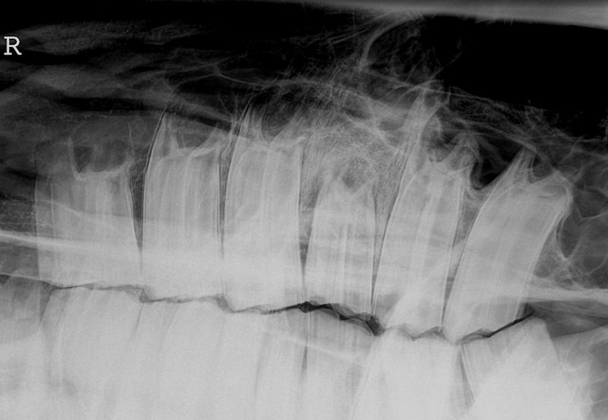
Lateral oblique radatiographs of the right maxillary arcade are shown below (rostral is shown to the left of the image) PROVIDE THIS IMAGE TO THE CANDIDATE

Slide 9
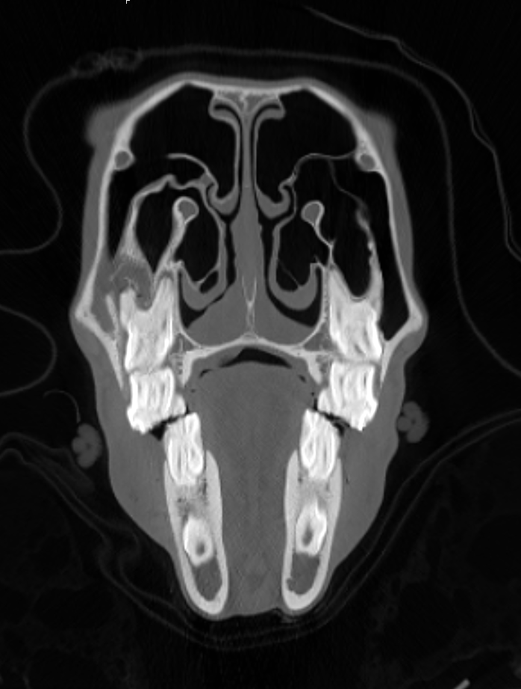
CT images of the head are performed and a representative section taken at the level of tooth 109 is shown below PROVIDE THIS IMAGE TO THE CANDIDATE

Slide 10
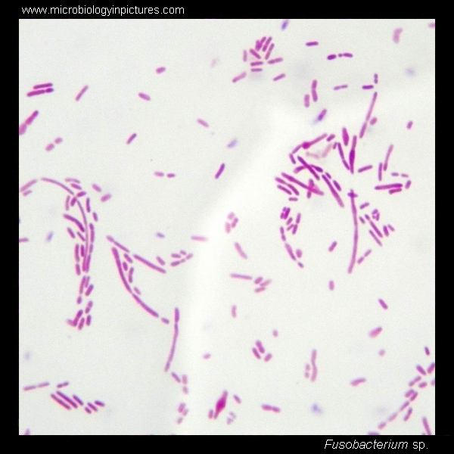
CSF Cytology and culture PROVIDE THIS TO THE CANDIDATE
Appearance: Cloudy
WBC Count: 20 x 109/L
Total protein: 300mg/dl
Comment:
85-90% lytic neutrophils;
Most of the rest are small lymphocytes
Occasional cytophagia of neutrophils by large mono-nuclear cells
Bacteria are seen within neutrophils and extra-cellularly

Slide 11
Question 4
What is your diagnosis?
Unacceptable | The borderline candidate | A new diplomate | The advanced diplomate
Bacterial meningitis | meningitis secondary to dental disease | Abscess (focal signs) secondary to spread from dental disease | Localised abscess eg pituitary Discusses literature
 | Major prompting |  | No Prompting

Slide 12
Source | Relevance
Morgan, R.E., Fiske‐Jackson, A.R. and Biggi, M. (2020), Pituitary gland abscess in a horse subsequent to head trauma. Equine Vet Educ, 32: O36-O39. doi:10.1111/eve.13043 | Spread can be direct – eg from Gpouches as in this case or haematogenous although no CN deficits in that case

Slide 13
Question 5
The horse was euthanased and a pituitary abscess identified at post mortem. Comment on the rationale to euthanase the horse.
Unacceptable | The borderline candidate | A new diplomate | The advanced diplomate
Simply states poor prognosis | States prognosis poor, difficulty with drug distribution | Mentions literature Guarded to poor prognosis (Furr | Discusses literature is contradictory re prognosis – may texts state poor. 3/5 recorvered in one series

Slide 14
NB these aren’t on reading list but referred to in books
Source | Relevance
Smith, J. J., Provost, P. J., & Paradis, M. R. (2004). Bacterial meningitis and brain abscesses secondary to infectious disease processes involving the head in horses: seven cases (1980–2001). Journal of the American Veterinary Medical Association, 224(5), 739-742. | Poor prognosis
Mitchell, E., Furr, M. O., & McKenzie, H. C. (2006). Bacterial meningitis in five mature horses. Equine Veterinary Education, 18(5), 249-255. | 3/5 survived – all Staph aureus
Bach, F. S., Bodo, G., Kuemmerle, J. M., Bienert‐Zeit, A., Hainisch, E. K., & Simhofer, H. (2014). Bacterial meningitis after sinus surgery in five adult horses. Veterinary surgery, 43(6), 697-703. | All died
Toth, B., Aleman, M., Nogradi, N., & Madigan, J. E. (2012). Meningitis and meningoencephalomyelitis in horses: 28 cases (1985–2010). Journal of the American Veterinary Medical Association, 240(5), 580-587. | 95% mortality

