Slide 1
CJT Example 2

Slide 2
Clinical judgement test
Aims
Test clinical application and ability to justify clinical decision making
Knowledge of disease pathophysiology
Knowledge of the evidence base on which decision are made

Slide 3
Using this case
We recommend you review this document with a resident buddy or supervisor
Each question would have examples of evidence for examiners to review as shown from the example used at summer school
We have not completed these – but it would help with your understanding of this case to develop these from the reading list
Source | Relevance
Morgan, R.E., Fiske‐Jackson, A.R. and Biggi, M. (2020), Pituitary gland abscess in a horse subsequent to head trauma. Equine Vet Educ, 32: O36-O39. doi:10.1111/eve.13043 | Spread can be direct – eg from Gpouches as in this case or haematogenous although no CN deficits in that case

Slide 4
Case
SIGNALMENT | A 12 year old cob gelding weighing 660kg with a body condition score of 5/5
PRESENTING SIGNS | Poor performance
HISTORY Physical examination ECG | The horse is used for general riding activity including hacking, dressage and low level show-jumping (90cm). The owners have noticed a gradual deterioration in performance over the last 4-5 months, thought to be caused by lameness of the left hindlimb. The horse is scheduled to undergo exploratory tenoscopy to evaluate tenosynovitis of the digital flexor tendon sheath of the left hind limb. The most likely differential diagnosis is of a traumatic lesion of the manica flexoria. The anaesthetist has identified a cardiac dysrrhythmia on pre-anaesthetic assessment Quietly, alert and responsive Temp: 37.3’C; respiratory rate 10 breaths per minute; Heart rate 36 bpm; irregular. No audible murmurs. S1,2 and 3 audible MM: pink and moist; CRT: < 2 sec Thoracic and abdominal auscultation – otherwise within normal limits No nasal discharge, no lymph node enlargement

Slide 5
Question 1
What is the relevance of this finding to the anaesthesia/surgery? How will you evaluate the risks? (30)
Unacceptable | The good generalist | A new diplomate | The advanced diplomate
Mentions irregular Makes inaccurate conclusions about impact on anaesthesia | Diagnoses AF Gives an opinion on impact of anaesthesia (likely limited) without reference to evidence of ASA categorisation | Discusses role of atrial function on cardiac output as a rationale for limited impact on anaesthesia Discusses ASA risk for this horse (AF) | Discusses evidence for good cardiac function of horses with AF under anaesthesia, although these are largely TVEC studies Discuss ASA risks including obesity
No mention that AF may be underlying cause of poor performance | Mentions relevance to poor performance. Identifies value of echo in further determining prognosis | Discusses potential performance limitations in relation to safety AND cardiac output need for exercising ECG and limitations of echo (usually normal given no murmur) | Discusses in detail potential consequences of AF as a reason to evaluate before performing elective surgery need for exercising ECG. Discusses echo in light of cycle length etc
Limited evidence base | Evidence base from books | Evidence base from single sources | Integrates information from multiple original sources

Slide 6
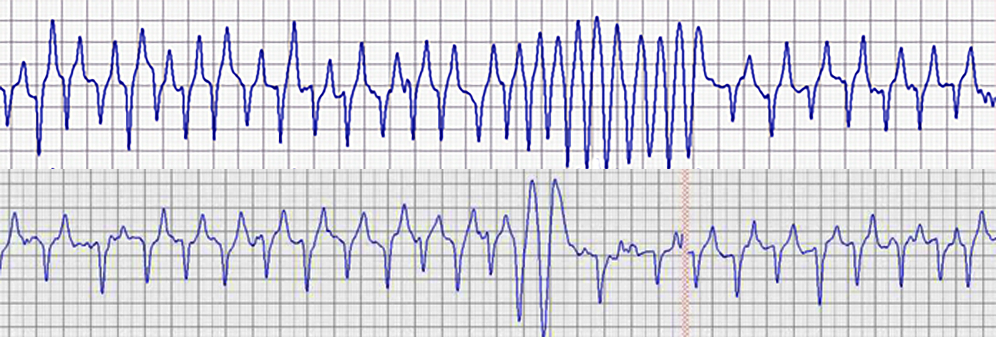
New information
You have diagnosed atrial fibrillation and perform an exercising ECG. The recording of which is attached.
Justify your response to this finding

Slide 7
Question 2
How will you proceed? Justify your response to this finding (40)
Unacceptable | The good generalist | A new diplomate | The advanced diplomate
Mentions tachycardia | Mentions VT | Mentions rate and rhythm as potential cause for collapse Discusses consensus statement | Critically reviews the evidence that VT is a poor prognostic findings (ie only one horse reported to have died)
Concludes need for retirement | Mentions indication for conversion and selects QS or TVEC | Discuses briefly indications and contraindications for conversion (chronicity, loud s3) and justifies QS/TVEC b | Discusses published success rates given chronicity given AF likely over 3 month duration. Discusses VT at rest – although no evidence predicts VT during QS
Cancel surgery | Delay surgery with limited explanation | Justifies decision to either delay or proceed with surgery | Includes recovery time post conversion and surgery may coincide.
Limited evidence base | Evidence base from books | Evidence base from single sources | Integrates information from multiple original sources

Slide 8
Question 3
Other than chronicity of AF, what other factors can help predict outcome?
Unacceptable | The good generalist | A new diplomate | The advanced diplomate
Unable to give answers | Underlying disease (not relevant in this horse) | Discusses atrial dimensions | Discusses atrial dimensions – although decrease post conversion Discusses atrial function (cycle length) and fractional area change
Limited evidence base | Evidence base from books | Evidence base from single sources | Integrates information from multiple original sources

Slide 9
Question 4
Describe your treatment for this horse
Unacceptable | The good generalist | A new diplomate | The advanced diplomate
Discusses protocol but no details for chosen method | Discusses protocol in some detail QS by NGT q2h. Until conversion, QRS prolongation or 5 doses but limited justification TVEC – location of catheters | Discusses protocol in detail QS by NGT q2h for 5 doses – then steady state at average half life. Discusses QRS prolongation as proxy for QS TDM. Adverse events mentioned TVEC Describes location of catheter, delivery of energy on R wave – use of | Discusses protocolsQS – dose and non dose related. How to avoid TVEC detail of how to determine location of catheters and rationale – ultrasound, radiography, pressure – in detail. Delivery of energy on R wave
Outlines risks of conversion | Mentions adverse events | Some discussion of adverse events and other medication | Discusses potential adverse events and other medications
Limited evidence base | Evidence base from books | Evidence base from single sources | Integrates information from multiple original sources

Slide 10
New information
You perform TVEC and have placed catheters in the left pulmonary artery and the right atrium. The horse is anaesthetized and a surface electrode connected.
The ECG shows ventricular synchronization

Slide 11
Question 5
Discuss the ECG – how will you progress?
Unacceptable | The good generalist | A new diplomate | The advanced diplomate
Identifies features of the ECG | Identifies features of the ECG and t wave syncing without discussing significance | Discusses t wave syncing and potential for VF Reposition ECG prior to shocking | Discusses ventricular sodium channel inactivation at time of QRS May cause VF Delivery of energy post T wave would still be acceptable but changing leads or moving electrodes ideal
Limited evidence base | Evidence base from books | Evidence base from single sources | Integrates information from multiple original sources

Slide 12
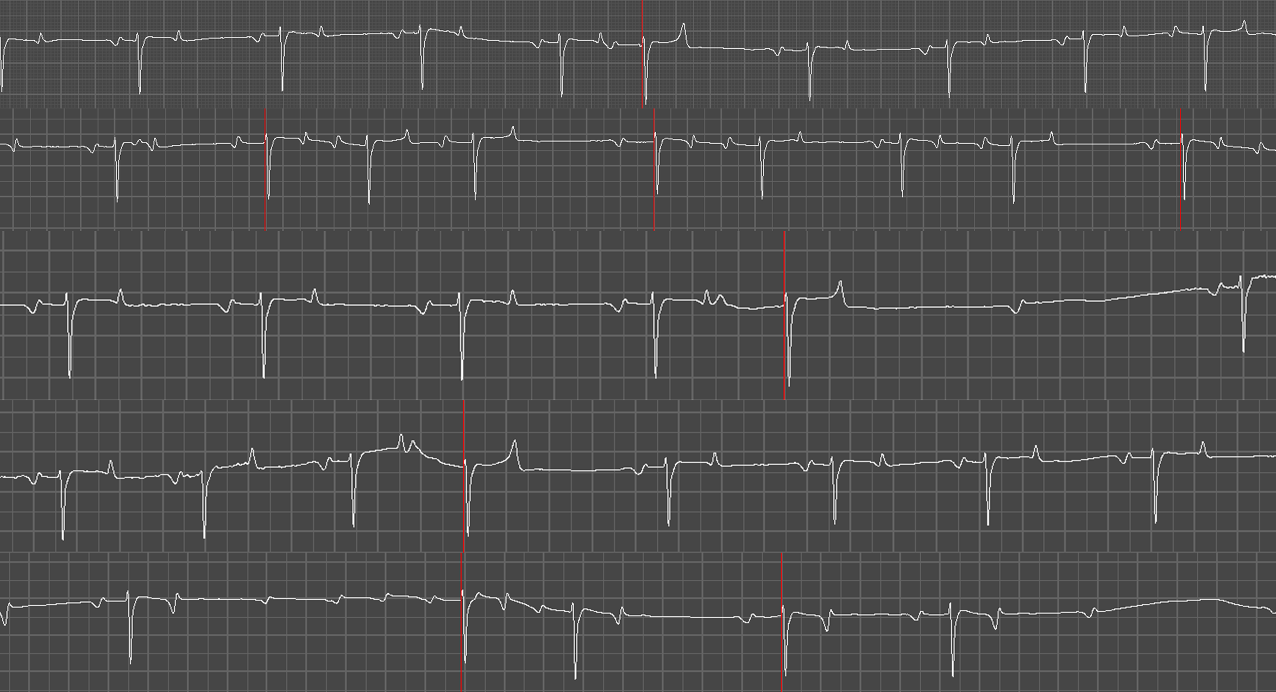
Following conversion
The following ECG was recorded 5 days post conversion

Slide 13
Question 6
What is the significance of this recording?
Unacceptable | The good generalist | A new diplomate | The advanced diplomate
Unable to properly describe rhythm | Mentions APCs | Mentions APCs and AVB and run of atrial tachycardia Mentions likely to predict recurrence of AF | Discusses atrial arrhythmias and discusses significance Critically evaluates in light of literature and potential candidate for ablation if recurs
Limited evidence base |  | Evidence base from single sources | Integrates information from multiple original sources

Slide 14
Scores
Question | No answer (0) | Unacceptable (2) | Good generalist (4) | New diplomate (6) | Experienced diplomate (10)
1
1
2
2
2
3
4
4
5
6

Slide 15
What is a passmark?
Each question will be standard set to establish a cut score for passing.
For this question it is estimated that a passmark would be 50%
Each row in each table will be assigned points (1-10) using the rubrics enclosed

