Slide 1
CJT Example 3

Slide 2
Clinical judgement test
Aims
Test clinical application and ability to justify clinical decision making
Knowledge of disease pathophysiology
Knowledge of the evidence base on which decision are made
References
As with previous cases – reference are not provided but reviewing this evidence is considered useful in your preparation for examination.s.

Slide 3
Case
SIGNALMENT | 8 hours old Standardbred colt foal – intended for racing.
PRESENTING SIGNS | Recumbent and unable to stand
HISTORY Physical examination | Unattended foaling 10 days prior to calculated term (day 320) Owner reports placenta looked yellowish. Vaccination history unknown. Mare had live, full term foal two years ago, late abortion last year. Owner has fed foal some colostrum from a bottle, poor suckle reflex noted. Foal has not stood up. Recumbent. HR 48, 2/6 sysyolic murmur on LHB Weak peripheral pulses and cold extremities Membranes pale grey, CRT 4 seconds Rectal temperature - below threshold No menace, weak withdrawal reflex, no entropion Joints and umbilicus normal by palpation Soft hair coat, bulging forehead, normal ear position FURTHER INFORMATION WILL PRESENTED DURING THE COURSE OF THE EXAMINATION
 | Result | Reference |  | Result | Reference
PCV (l/l) | 0.23 | 0.32-0.46 | CK (IU/l) | 2770 | 400-909
 |  |  | GLDH (IU/l) | 10.56 | 8.0-43.0
Haemoglobin (g/L) | 83 | 110-190 | GGT (IU/l) | 24 | 18-43
WBC (x10⁹/L) | 2.3 | 4.9-11.7 | SAA (mg/l) | 5 | 0-36.6
Neutrophils (x10⁹/L) | 1.0 | 3.4-9.6 | Fibrinogen (g/l) | 3.0 | 0.3-3.9
Band neutrophils (x10⁹/L) | 0.5 | 0-0.1 | Protein (g/l) | 25 | 43-81
Lymphocytes (x10⁹/L) | 0.7 | 0.7-2.1 | Albumin (g/l) | 20 | 25-36
Monocytes (x10⁹/L) | 0.3 | 0.1-0.4 | Creatinine (umol/L) | 1061 | 106-380
Eosinophils (x10⁹/L) | 0.0 | 0-0.02 | Glucose (mmol/l) | 1.4 | 6.7-12.9

Slide 4
Arterial blood gas analysis
 | Results | Reference
PaCO₂ (mmHg) | 65 | 36-46
PaO₂ | 45 | 80-112
Lactate (mmol/L) | 16 | <2
Saturation of oxygen,s0₂, (%) | 85% | >93

Slide 6
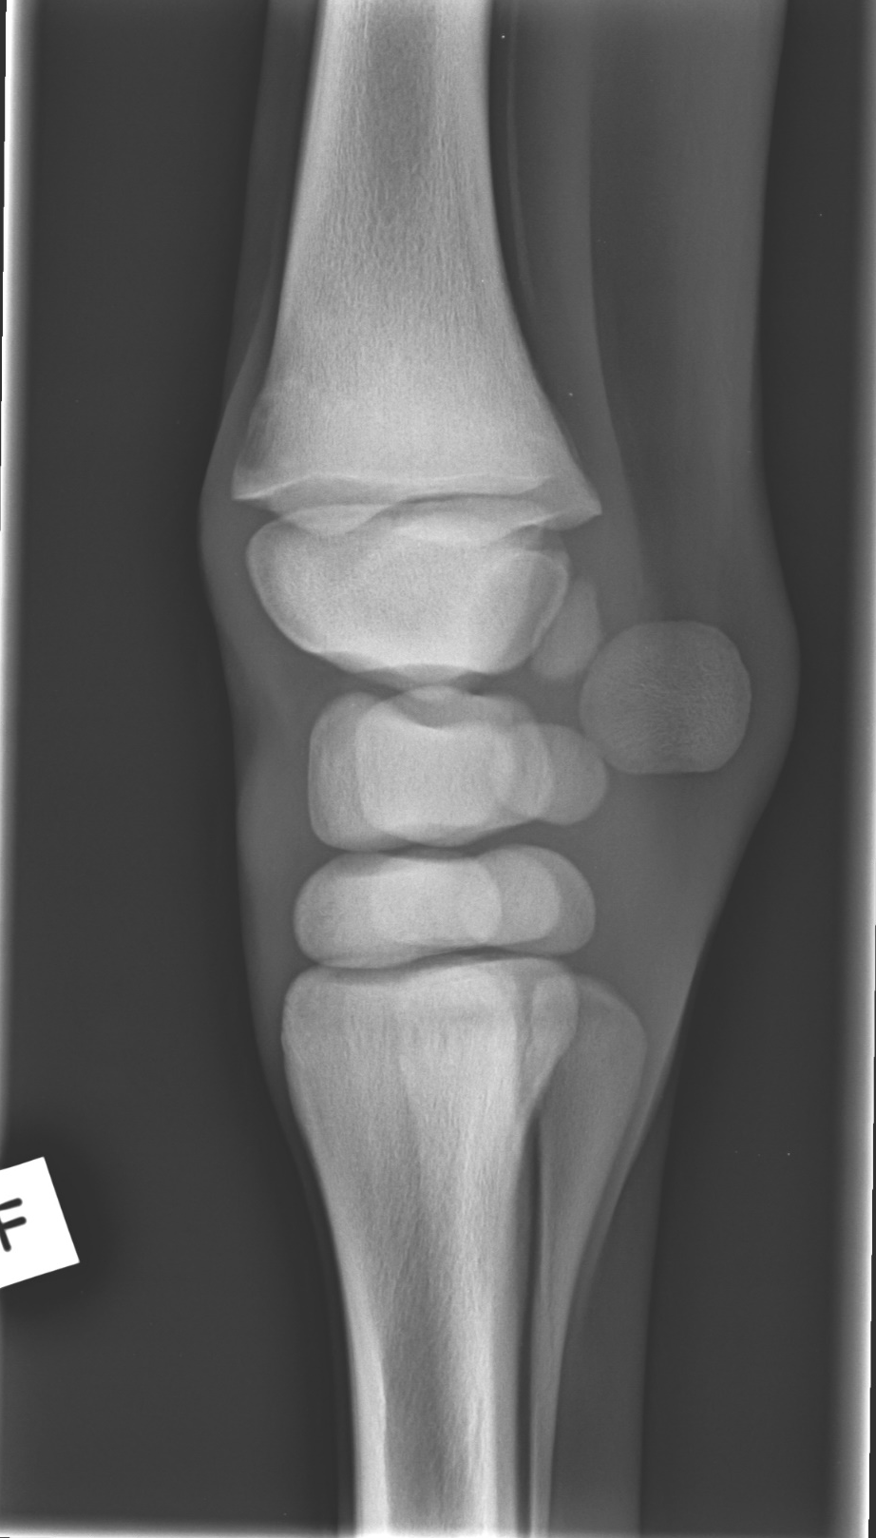

Slide 7
stop
THE REMAINDER OF THIS CASE WOULD BE PRESENTED DURING YOUR ASSESSMENT

Slide 8
Question 1
Discuss your initial assessment of this foal?(40) Prompt: what are your primary problems – how will you manage these
Unacceptable | The good generalist | A new diplomate | The advanced diplomate
Does not recognise as dysmature | Clinical signs of dysmaturity but unable to rationalise gestational length | Recognises dysmature despite prolonged gestation | Dysmaturity despite prolonged gestation Resulting from placental insufficiency and likely a result of placentitis (high creatinine) resulting in IUGR
Lung disease attributed only to aspiration | Pulmonary dysfunction with hypoxia and hypercapnia does not relate these to radiographic findings or dysmaturity | Pulmonary dysfunction as a result of atelectasis with possible exacerbation due to aspiration pneumonia due to bottle feeding with poor suckle reflex | Pulmonary dysfunction (hypoxia and hypercapnia) as a result of atelectasis (from radiograph) due to inadequate lung maturation Discusses steroid release during disease and lung maturation May be exacerbated by aspiration pneumonia secondary to poor suckle reflex
sepsis through aspiration/ umbilicus | Sepsis is identified without linking to FTP or recumbency | Recognises sepsis based on blood results and predicts FTP Identifies likely sources of sepsis Mentions glucose | Sepsis and FTP (not properly nurses) Not stood Uterine pathology Link to laboratory findings despite normal SAA Identifies likely sources of sepsis Hypoglycaemia – intake
Focuses on lactate and creatinine – recumbency due to neonatal encephalopathy not hypotension | Discusses hyperlactaemia as evidence of hypovolaemia Links HR to K+ | Recognises hyperlactaemia is more than just hypovolaemia Discusses bradycardia potential causes – recognises likely cause of recumbency | Hyperlactaemia likely from hypovolaemia, hypoventilation (type A) and sepsis (type B) Bradycardia – not related to hypotension ?K rarely vagal Relates to recumbency while also discussing encephalopathy

Slide 9
You diagnose the foal as being
Dysmature
Hypoxic and hypercapnic with lung dysfunction related to atelectasis secondary to dysmaturity
Septic with failure of passive transfer
Hypovolaemia
Bradycardia – serum potassium concentration is normal
How will you initially manage these problems

Slide 10
Question 2
Describe your initial stabilisation of this foal (40)
Unacceptable | The good generalist | A new diplomate | The advanced diplomate
Relies on pharmacological interventions (doxapram / caffeine) without oxygen | Intranasal oxygen described in management of hypoxia. Discussion of caffeine | Critically evaluates need for respiratory support and limitations of pharmacological support. Recommends ventilation with limited detail. | Primary management of lung dysfunction should be through ventilation, discusses advantages of PEEP / SIMV. Discusses airway drying and increase risk of disease
Nutritional management relies upon enteral feeding | Able to discuss concerns with enternal nutrition but formulation of pareneteral fluid plan is limited | Nutrional support using IV glucose, justified on basis on poor intestinal perfusion. Justifies indications for TPN | Nutritional support : Develops robust nutritional plan using TPN or glucose and insulin predicting IR able to justify and consider risks (thrombosis)
Reliance on antibiotics administration using high priority CIAs without being able to justify their use | Recommends plasma Formulates an antibiotic plan based on broad spectrum | Recommends plasma and justifies source Able to recommend rational antibiotic regime vs G+ and G- sepsis and volume of distribution Addresses relevant dosing for foal Considers important of 3rd generation cephalosporins | Sepsis: Addresses FPT addressing advantages of hyperimmune fresh frozen plasma in – discusses advantages over maternal plasma. Antibiotic choice a balance on predicted susceptibility and resistance. Discusses emerging published resistance in foals
Formulates plan for crytalloids and colloids with limited discussion of benefits No mention of pharmacological agents | Discusses crytalloid and colloid plan Limited discussion of pressors Limited mention of management of bradycardia – reliance of vagolytics | Discusses crystalloid therapy plan and use of pressors in the event of lack of response but does not discuss CIRCI and use of C/S Discusses pharmacological management of bradycardia – although atropine unlikely to be effective | Cardiac :Discuss and critiques crystalloid bolus, and colloids. If no improvement, pressors (dobutamine, vasopressin) – corticosteroids if resistant to therapy. Discusses evidence for use including CIRCI Management of bradycardia – vagalytics unlikely to be effective – norepi/ pacing

Slide 11
After initial stabilisation – 4 days later
QAR. Occassionally ambulating and has nursed from mare with help.
Still on intranasal O2 at 10L/min but blood gas improved.
T 39.6
HR 108
RR 52, mild amount of mucoid nasal discharge
Joints normal on palpation
Umbilicus slightly moist and dribbles during urination
Mucous membranes pink and moist
Ultrasound shows...

Slide 12
Notes:
Make sure loop works!!

Slide 13
Question 3
Discuss and justify your management(20)
Unacceptable | The good generalist | A new diplomate | The advanced diplomate
Suggests septic without evidence and no mention of patent urachus | Unable to identify all structures Suggests likely septic without robust justification Diagnosis of patent urachus | able to identify all structures Recognises persistent urachus but does not discuss likely causes Suggests likely septic focus but considers other factors | able to identify all structures Persistent urachus as hypoechoic fluid can be noted in umbilical stump Can be due to infection but excessive handling and abdominal pressure can also cause patency uneven size of arteries is normal at this age but could also be sign of early infection
Gives very superficial therapy descriptions not discussing balance of need for medical or surgical intervention or focuses need based on minor factors (eg anaesthetic risk) | Unable to justify choise of medical or surgical intervention but indicates both effective and limited clinical detail of intervention. Bases decision on minor factors (eg anaesthetic risk/ adhesions) rather than global outcomes | Justifies medical or surgical outcomes based on clinical experience of selected sources of evidence of outcomes (more than anaesthetic / surgical risk) Gives details of therapy that are robust and appropriate | Justifies medical or surgical intervention based on evidence of outcomes being able to give overview of data Gives details of therapy that are robust and appropriate

Slide 14
Scores
Question | No answer (0) | Unacceptable (2) | Good generalist (4) | New diplomate (6) | Experienced diplomate (10)
1
1
1
1
2
2
2
2
3
3

